Slide 1
Getting Assets
Interactive Media
Unit 1

Slide 2
Starter – 5 Minutes
Answer the following on your whiteboards:
List three ways you could create assets for a product.
If you were to make a game, what are some textures you might need? (Images to use on objects)

Slide 3
Learning Outcomes
Understand how assets are gathered.
Describe the different self-sources of assets.
Create some assets to use.

Slide 4
What is an Asset?
Assets are the content used within an interactive media product such as backgrounds, textures, models and music.
These mostly fall under the following categories:
Sound
Images
Videos
Models

Slide 5
Types of Source
What are the three main types of source covered previously?
Self-Sourced
External Source – Premium
External Source – Free (Creative Commons)

Slide 6
Self-Sourced Assets
Self-sourced assets are those that have been created by yourself, normally using equipment.
On your whiteboards:
Write down what tools or hardware you might need to create assets for an interactive media product.
(Think about the different types of assets mentioned earlier)
Camera, Microphone, what else?

Slide 7
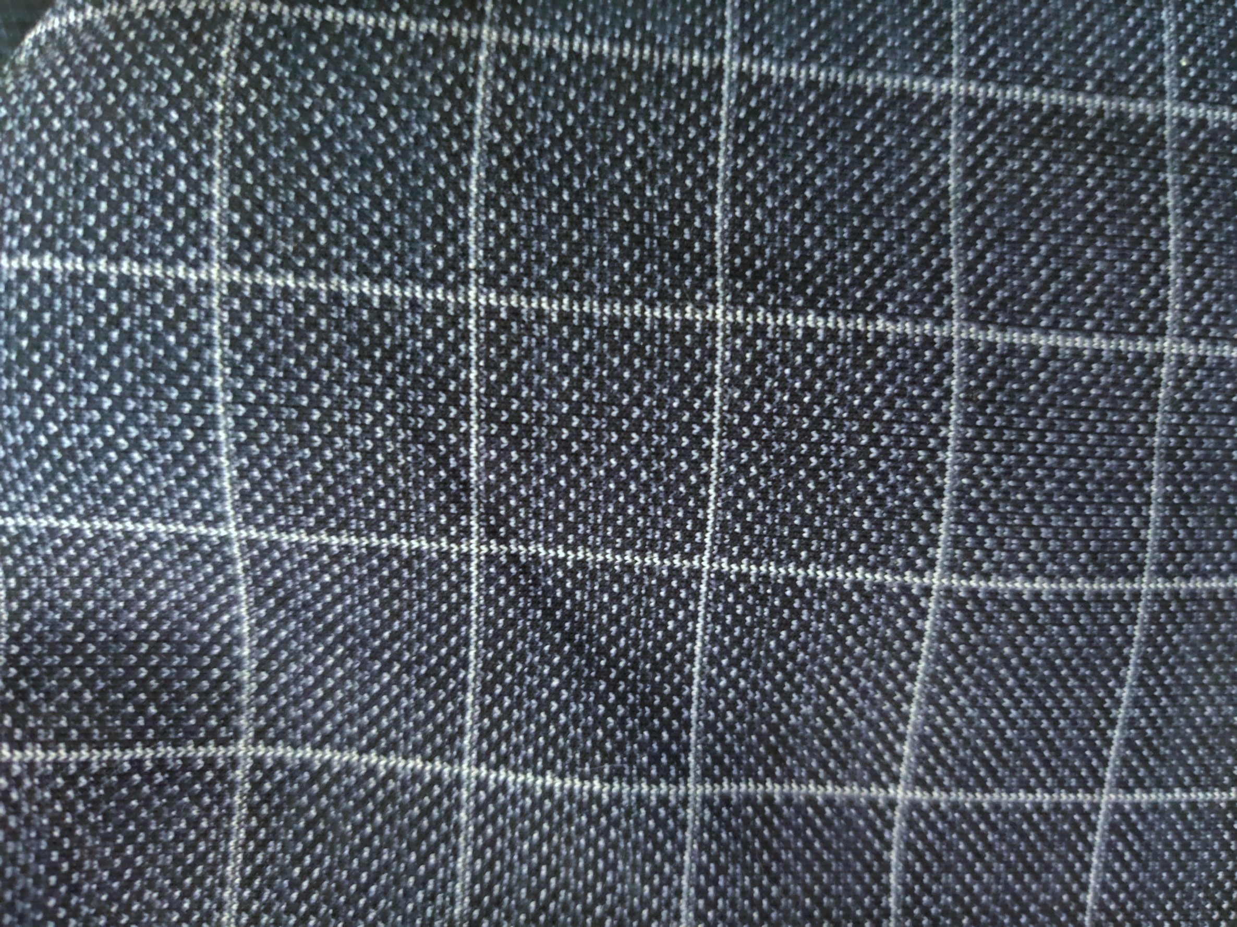
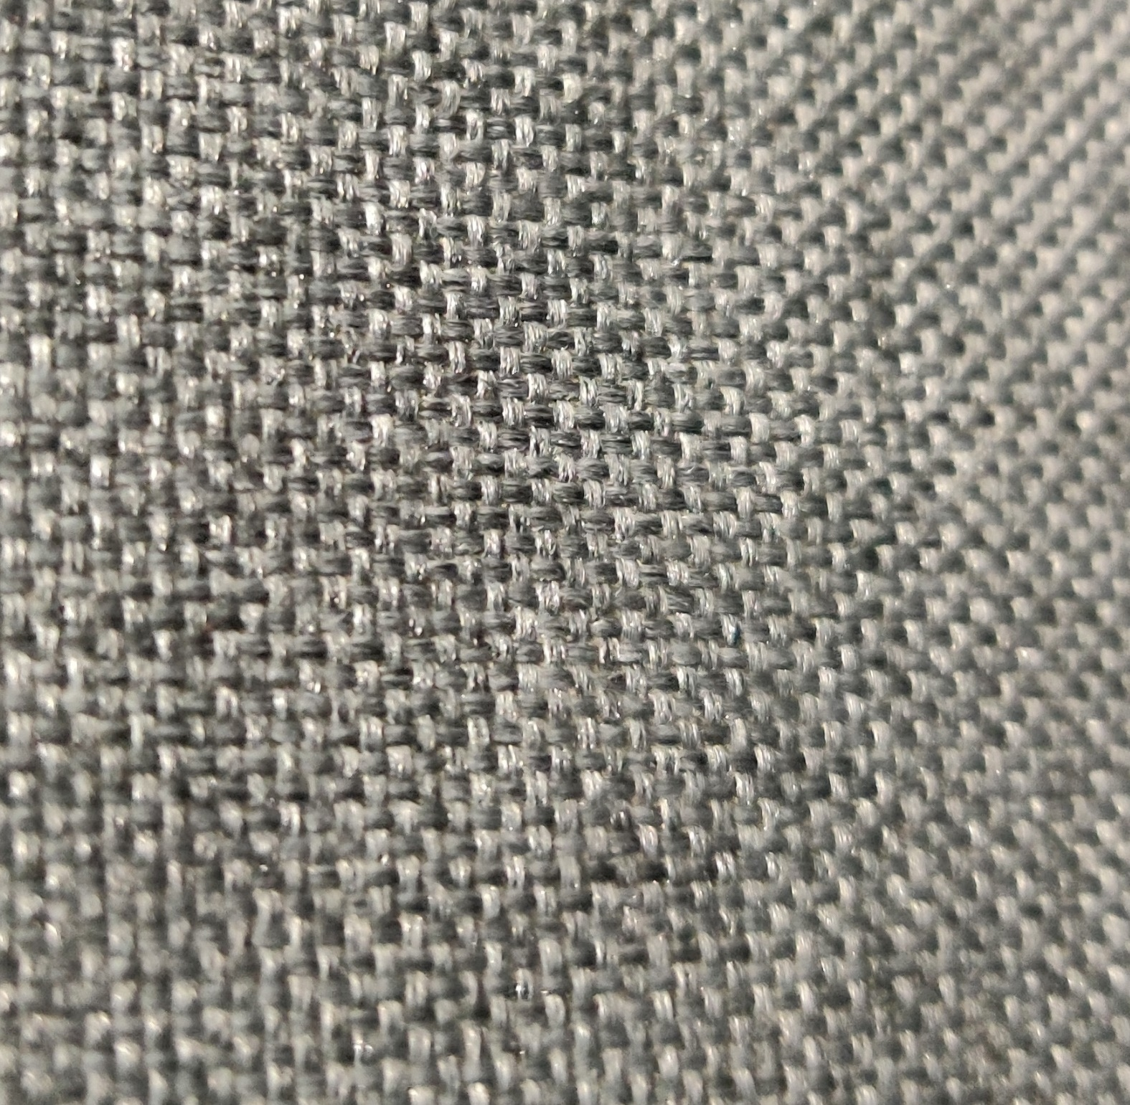
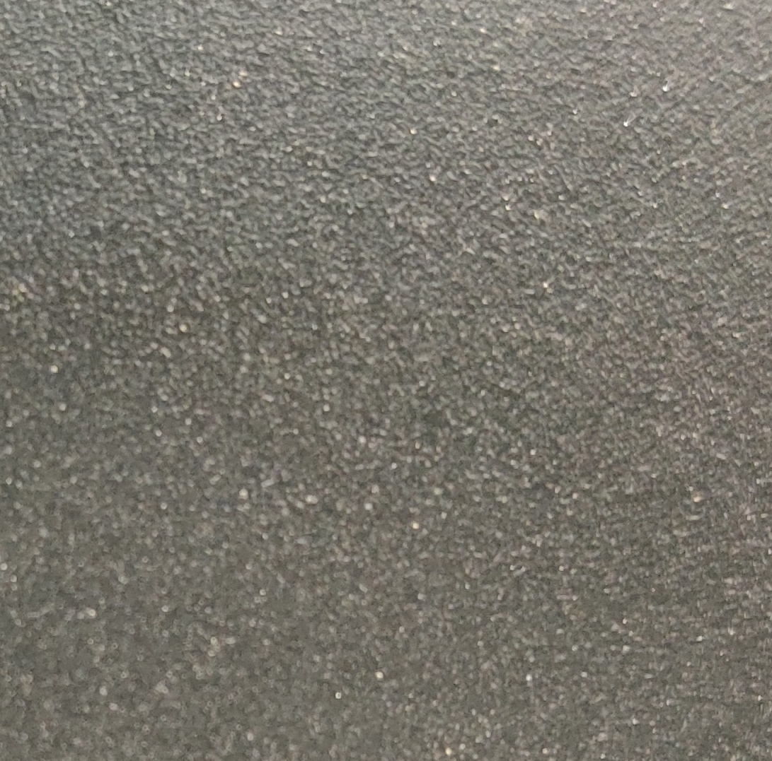


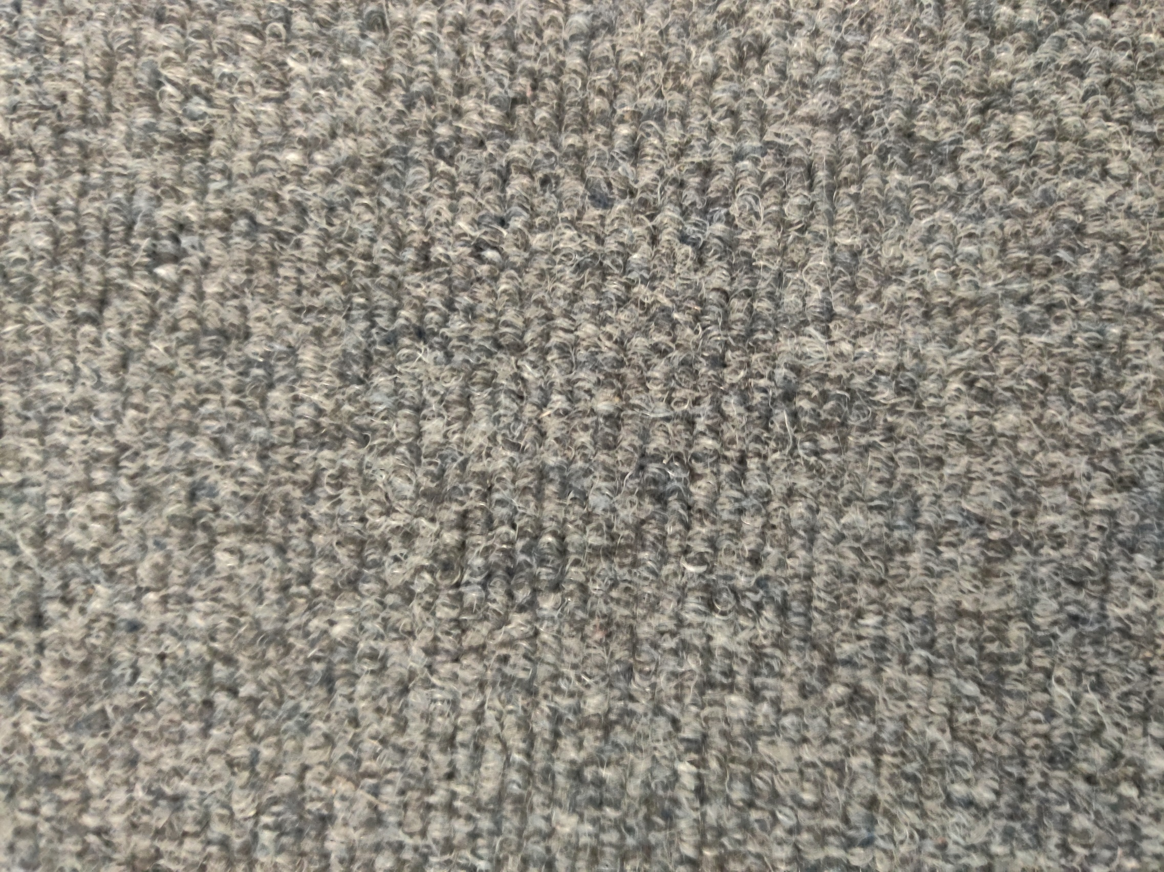
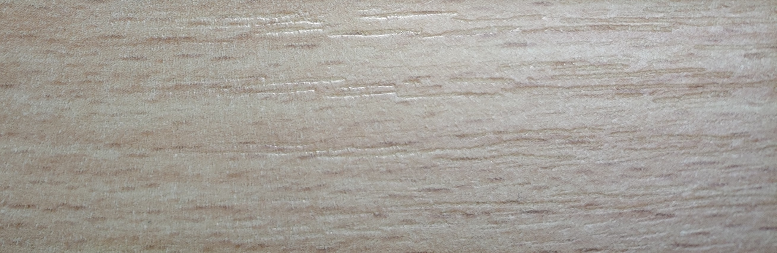

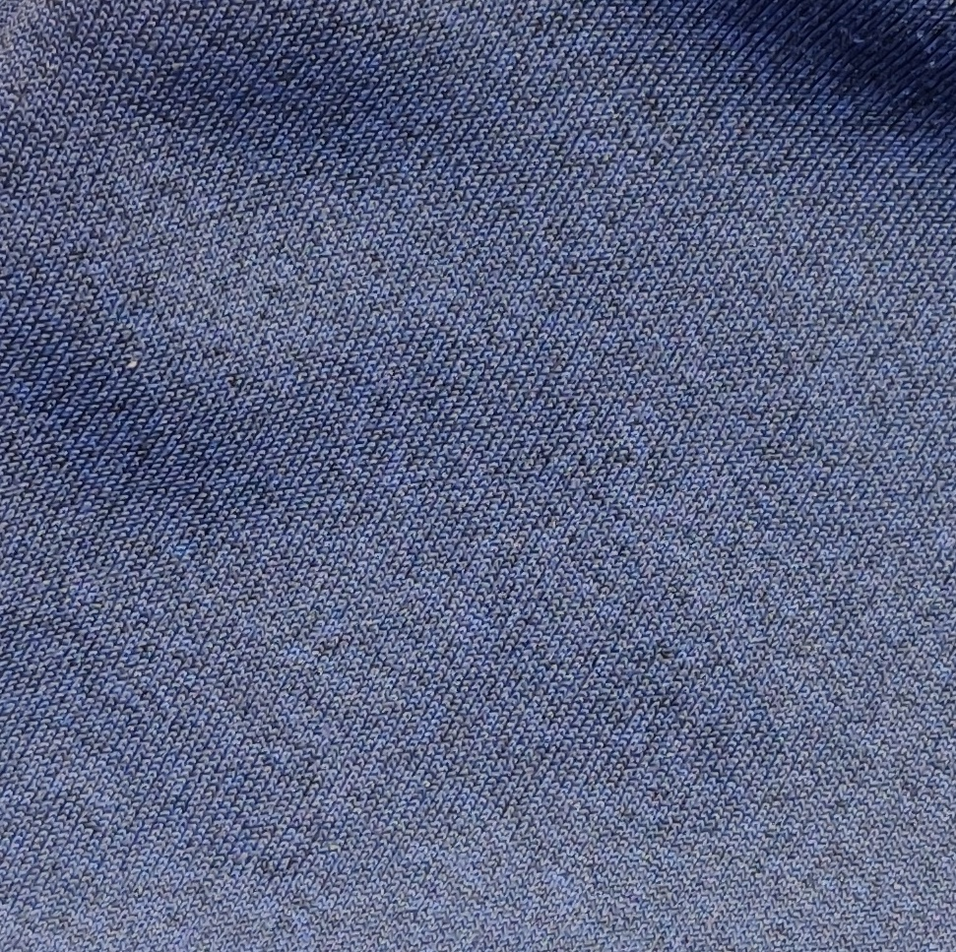
Examples of Assets
Here are a few examples of image assets that can be used in an interactive media product.
Remember, these assets can be used for more than just their original image.
E.g. a photo of a jumper could be used as a texture for something else such as a blanket.

Slide 8
Task 1 – Gathering Assets
Either working on your own or with a partner (if you don’t have a camera available:
Take pictures of various different surfaces and materials to use as assets.
Tips:
Avoid using flash, you will typically end with a large white blob in the middle of your photo.
Don’t get too close, your camera may struggle to focus and the colours might get washed out.
Take a picture of the whole object (e.g. the chair) and a close-up of a material to help you remember what the close-up is.
Avoid blocking the light with your phone or you’ll end up with a big shadow in the way!

Slide 9
Task 2 – Teams Upload
So you don’t accidently delete the images, upload your photos on to the upload point on Teams.
If you have too many images, pick your favourite ones and upload them, keep the others in your school files.

Slide 10
Task 3 – Editing Assets
Although some of your assets may be perfectly usable already, some might need a little work.
Move the assets that you want to edit into a folder, in the future, we will be working on Photoshop again, so you can edit them then.
If your images are too blurry, you won’t be able to fix that with Photoshop, but don’t delete them, try zooming in to part of the photo, that could be its own asset.

